Slide 1
Financial Condition Review
Heath City School District
November 7th, 2018
Facilities Financial task force meeting

Slide 2
Discussion Items
Does Heath City School District (CSD) spend its money wisely?
Do taxpayers pay a fair amount?
Why do School Districts need for more money?
  When did Heath CSD last get new money?
  When will Heath CSD need new money?

Slide 3
Does Heath CSD spend its money wisely?
CUPP Report
General Fund Sensitivity Analysis w/ average expenditure growth
Heath spends $1,975,747 less per year than the State Average based on 1,687 students
Ten Year Average
District had a balanced budget for 7 out of the last ten years!
* As determined by Ohio Department of Education

Slide 4
Do taxpayers pay a fair amount?

Slide 5
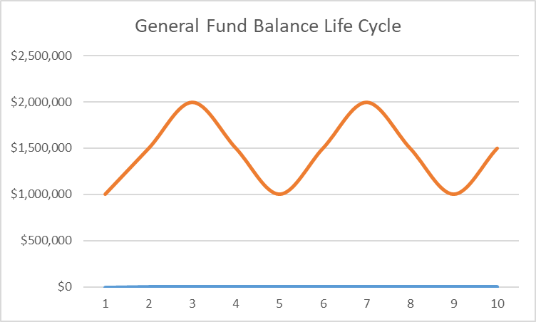
Why do Schools need more money?
Years

Slide 6
Why do Schools need more money?
District’s funds run low and reaches the minimum recommended balance
Year

Slide 7
Why do Schools need more money?
District’s passes a new levy to rebuild the balance
Year

Slide 8
Why do Schools need more money?
Fund balances decline again as expenses grow with inflation
Year

Slide 9
Why do Schools need more money?
And so on, and so on, and so on
District’s passes a new levy to rebuild the balance
Year

Slide 10
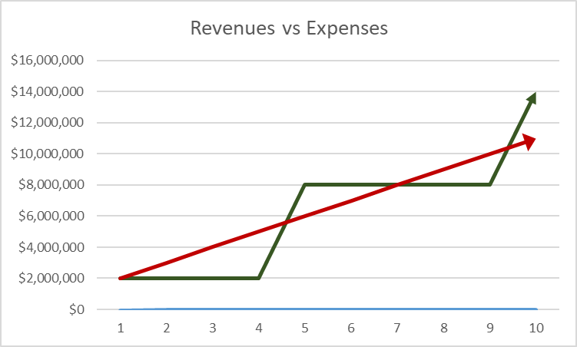
Why do Schools need more money?
Revenues
Expenses
Year

Slide 11
Why do Schools need more money?
Spending exceeds revenues causing balances to decline
Year

Slide 12
Why do Schools need more money?
District passes levy causing revenues to increase and balances to grow
Year

Slide 13
Why do Schools need more money?
Spending exceeds revenues causing balances to decline
And so on, and so on, and so on
Year

Slide 14
  When will Heath CSD need new money?
What does a Treasurer do?
Background
Forecasting Philosophy
Forecasting Process

Slide 15
Revenue Overview

Slide 16
Property Taxes
Local Taxes are expected to remain stable.
Businesses pay almost half of all local taxes.
Conflicting forces result in flat valuations.
Strong collection rates expected to continue
 |  |  |  | FORECASTED
 |  |  | 2018 | 2019 | 2020 | 2021 | 2022 | 2023
Total With Renewal Levies |  |  | 8,886,791 | 8,789,872 | 8,815,319 | 8,845,696 | 8,865,052 | 8,862,683
YOY $ Change |  |  | 243,629 | (96,919) | 25,447 | 30,377 | 19,356 | (2,369)
Values, Tax Rates and Gross Collections |  |  |  |  |  |  | Gross Collection Rate
Tax Yr | Valuation | Value Change | Class I Rate | Change | Class II Rate | Change | Including Delinquencies
2017 | 259,175,790 | 22,674,384 | 37.20 | (1.98) | 38.05 | (1.89) | 100.0%
2018 | 259,776,883 | 601,093 | 37.00 | (0.20) | 37.92 | (0.13) | 98.4%
2019 | 259,974,301 | 197,418 | 37.07 | 0.07 | 38.02 | 0.10 | 98.4%
2020 | 265,212,081 | 5,237,780 | 36.79 | (0.28) | 37.62 | (0.39) | 97.7%
2021 | 265,436,486 | 224,404 | 36.86 | 0.06 | 37.72 | 0.10 | 97.6%
2022 | 265,679,371 | 242,885 | 36.83 | (0.02) | 37.72 | 0.00 | 97.3%

Slide 17
State Funding
State funding prioritized
based on “District Need”
Complex formula-driven funding based on:
  Student enrollment
  Funding per student
  Growth “caps”
Source of significant forecast uncertainty

Slide 18
State Funding
 |  |  |  |  |  |  |  | FORECASTED
 |  |  |  |  | 2018 | 2019 | 2020 | 2021 | 2022 | 2023
Total |  |  |  |  | 6,474,971 | 6,528,776 | 6,716,724 | 6,914,244 | 7,118,330 | 7,321,272
YOY $ Change |  |  |  |  | 210,419 | 53,805 | 187,948 | 197,520 | 204,086 | 202,942
Core Funding Per Pupil |  |  |  |  | 6,010 | 6,020 | 6,100 | 6,150 | 6,200 | 6,300
State Share Index (SSI) |  |  |  |  | 46.9% | 46.9% | 45.9% | 45.9% | 47.1% | 47.1%
State Core Funding Per Pupil |  |  |  |  | 2,819 | 2,823 | 2,797 | 2,820 | 2,918 | 2,965
Formula ADM (Funded Student Count) |  |  |  |  | 1,594 | 1,575 | 1,589 | 1,614 | 1,601 | 1,628

Slide 19
State Funding: Enrollment
Enrollment is expected to increase, but state funded ADM is stable
Open enrollment growth is driving enrollment growth

Slide 20
State Funding: Enrollment

Slide 21
Other Operating Revenues
 |  |  |  |  | 2018 | 2019 | 2020 | 2021 | 2022 | 2023
Open Enrollment In |  |  |  |  | 1,267,425 | 1,567,632 | 1,588,464 | 1,601,485 | 1,614,505 | 1,640,545
Investment Income |  |  |  |  | 85,274 | 115,365 | 126,350 | 99,543 | 66,734 | 40,257
Manufactured Home Taxes |  |  |  |  | 87,257 | 93,347 | 93,347 | 93,347 | 94,280 | 94,280
Other |  |  |  |  | 253,681 | 117,093 | 174,124 | 174,153 | 174,136 | 174,168
Total |  |  |  |  | 1,693,637 | 1,893,436 | 1,982,284 | 1,968,527 | 1,949,655 | 1,949,250

Slide 22
Expenditures Overview

Slide 23
Salaries & Benefits
FY 19 staffing is expected to increase largely because special education services were brought in-house and the District expects a net savings.
Improved special education identification is also driving 1-2 additional positions each year.
Teachers are expected to receive 2% raises each year and non-teachers receive 2.5% increases through FY 20 and then 2.0% afterwards.
Benefit costs are increasing in FY 19 because a billing delay caused 13 insurance payments in FY 19 and only 11 in FY 18.
Benefit costs are also increasing because more employees are opting for insurance in FY 19.
Health insurance is forecasted at 10% annual increases.

Slide 24
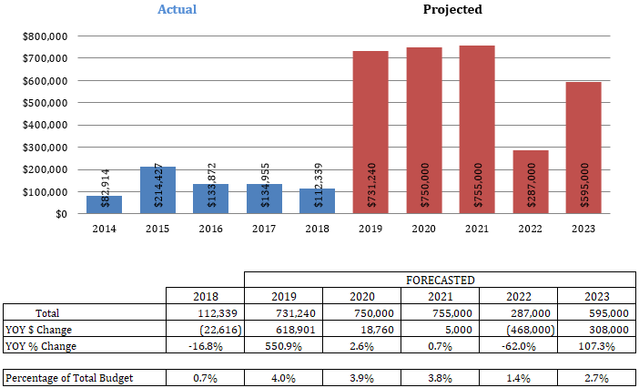
Capital Outlay
Due to past fiscal constraints, capital projects have been deferred historically. Extensive repairs are needed going forward.
Heath CSD does not have dedicated funding for permanent improvements like many other school districts.
Projections do not include capital projects for the Elementary schools in anticipation of renovation/ replacement or a potential permanent improvement levy.
If the High School and Middle School are renovated, some of these expenditures could be rolled into that project, which would reduce the impact on the General Fund.

Slide 25
Capital Outlay
 | FY19 | FY20 | FY21 | FY22 | FY23
Completed Projects:
High School Roof Section Replacement | 228,000
Van for small group transport- no CDL needed | 28,030
Garfield School Entrance Safety Renovation | 14,500
Bus Lease Payment | 25,526
New Telephone System | 34,184
Sub-Total | 330,240 | - | - | - | -
Anticipated Projects:
Replace Handicap Bus #18 (300,000 miles) | 91,000
Resurface track |  | 120,000
Replace Regular Bus (year 2000 but low miles) |  |  | 90,000
Replace Visitor Bleachers |  |  |  |  | 380,000
Computer Equipment/ Software | 75,000 | 60,000 | 60,000 | 60,000 | 60,000
Miscellaneous As Needed | 50,000 | 50,000 | 50,000 | 50,000 | 50,000
Sub-Total | 216,000 | 230,000 | 200,000 | 110,000 | 490,000
Anticipated Projects That Might be Included in HS/MS Renovations:
Middle School Entrance Safety Renovation | 50,000
Middle School Roof Replacement- Section 1 |  | 400,000
Middle School Roof Replacement- Section 2 |  |  | 400,000
MS & HS HVAC Replacement Plan | 135,000 | 120,000 | 155,000 | 177,000 | 105,000
Sub-Total | 185,000 | 520,000 | 555,000 | 177,000 | 105,000
CAPITAL OUTLAY TOTALS | $ 731,240 | $ 750,000 | $ 755,000 | $ 287,000 | $ 595,000

Slide 26
Purchased Services (Outsourced Services)
In-house spec. ed. services reduced contracted instruction services in FY 19, but a growing special education population is expected to increase future expenditures.
Open enrollment charges are expected to increase in FY 19 due to e-school closures

Slide 27
Projected 5 Year Financial Position
Financial Forecast |  |  |  | Fiscal Year | Fiscal Year | Fiscal Year | Fiscal Year | Fiscal Year
 |  |  |  | 2019 | 2020 | 2021 | 2022 | 2023
Beginning Balance |  |  |  | 8,824,948 | 9,674,964 | 9,832,722 | 9,417,606 | 8,804,850
+ Revenue |  |  |  | 19,045,635 | 19,495,908 | 19,713,790 | 19,923,893 | 20,127,332
+ Proposed Renew/Replacement Levies |  |  |  | - | - | - | - | -
+ Proposed New Levies |  |  |  | - | - | - | - | -
- Expenditures |  |  |  | (18,195,619) | (19,338,150) | (20,128,906) | (20,536,649) | (21,743,160)
= Revenue Surplus or Deficit |  |  |  | 850,016 | 157,758 | (415,116) | (612,756) | (1,615,828)
Ending Balance with renewal levies |  |  |  | 9,674,964 | 9,832,722 | 9,417,606 | 8,804,850 | 7,189,022
Revenues are expected to outpace expenditures until FY 2021. Thereafter, cash balances will be spent down to fund operations.
The District does not anticipate needing a new operating levy until after FY 2023 at this time.

Slide 28
Projected 5 Year Financial Position

Slide 29
Conclusions
District is spending wisely
The operating budget has been balanced 7 out the last 10 years
As a result the district is in good financial shape
Usually districts run out money every three to five years
Heath has operated on the last levy for last five years
And it appears it will last another five years, at least

Slide 30
Conclusions
As a result of good financial management, tax cost is low
The District spends nearly $2 million less per year than the State average
Ultimately, State funding will impact the District’s financial strength
Additionally, capital needs will start to erode the District’s cash reserves
All other expenses are well controlled
The District will not need an operating levy until after 2023!

